Slide 1
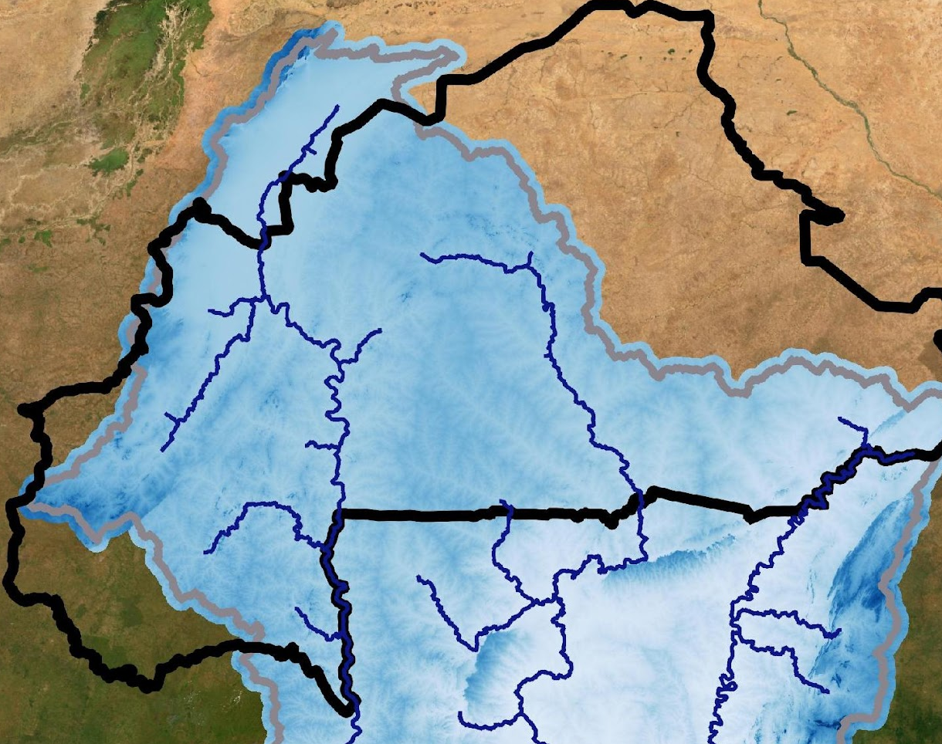
Volta DGRE
Jonathan Linnebach – Product Owner David Haasnoot – Scrum master Sophie Verheugd – Developer Sophie van Velzen – Developer Christine Martin – Developer Jesse van Leeuwen – Developer

Slide 2
Product goal:
“Map of proposed new reservoir locations and advice for feasible reservoir dimensions based on regional water demand and future population/climate changes”

Slide 3
Aspects analysed:
Socio-economic, demographic and political situation
Stakeholders
Climate
Data availability
Yearly water balance
Drought analysis
General water demand
Irrigation
Locations

Slide 4
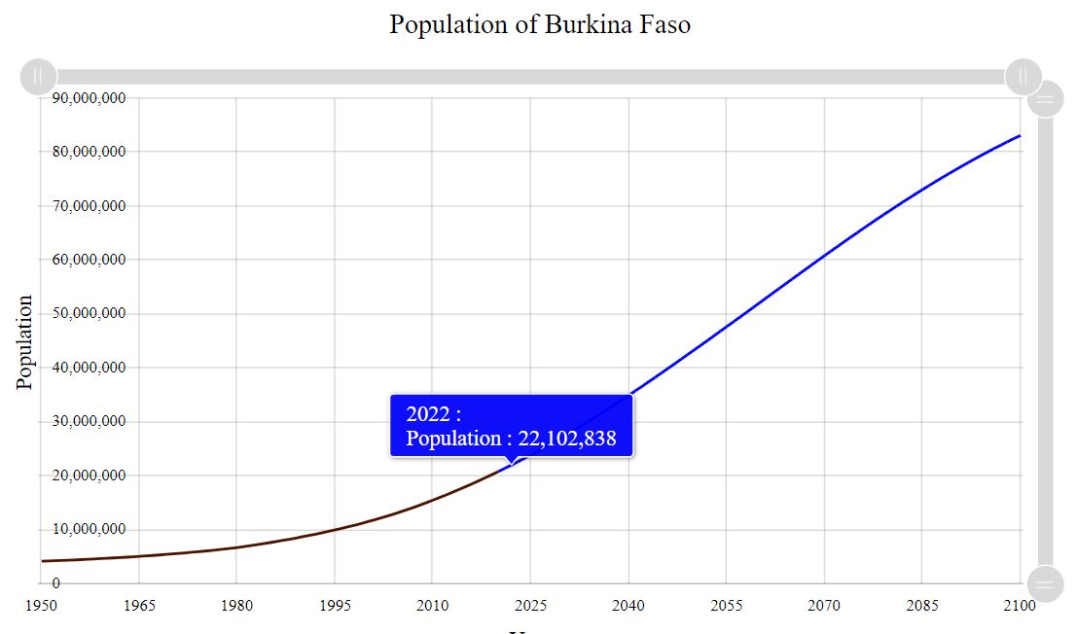
Socio-economic, demographic and political situation
Poor country
Terrorist attacks
Agriculture
Population growth
Notes:
First, we did some research into the country to know what we are dealing with. We found that Burkina Faso is one in the poorest countries in the world. At this moment, it is also a very unsafe country because of terrorist groups that are active in the region. Most of the population depends on agriculture, which highly depends on water availability. Burkina Faso is in a very large population growth. Right now, there are about 22 million people living in Burkina Faso. In 2050, the expected population size is more than 40 million. So in 27 years, the population size is going to double. In 2100, the expected population size is over 80 million. So in the last half of the century, the population will double again.

Slide 5
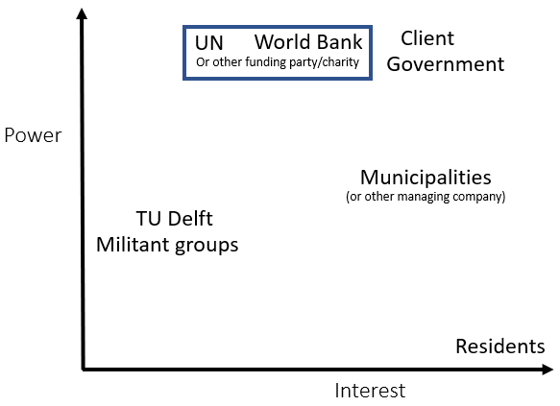
Stakeholder analysis
Client: General Directorate
of Water resources
Notes:
Our client, the General Directorate of Water Resources is part of a ministry and therefore part of the government. The main task of the Directorate is to take good care of the water resources in Burkina Faso, so therefore this stakeholder has high power and high interest. One big problem in this task, is that there often is not enough money. Because of this, they need a funding party to execute their plans. In the past, generous funders have been the World Bank and UN. In rural areas, municipalities are responsible for managing their local resources. Therefore, it is likely that they will have a role in building or managing potential reservoirs in their areas. This could also be done by other companies. The residents of Burkina Faso have the greatest interest in new reservoirs, so they have enough water to live. TU Delft plays a role in the development of reservoirs by providing knowledge, like through this project. Militant groups play a role because they occupy territories in Burkina Faso, which makes it hard to build there without their corporation.

Slide 6
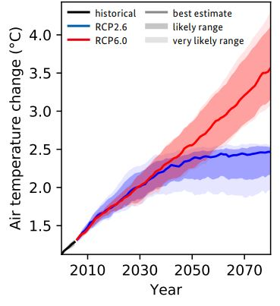
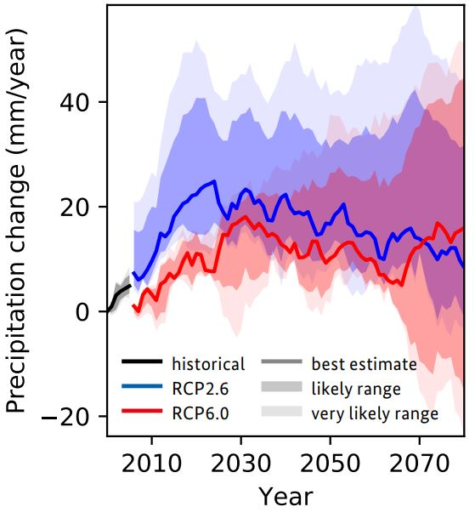
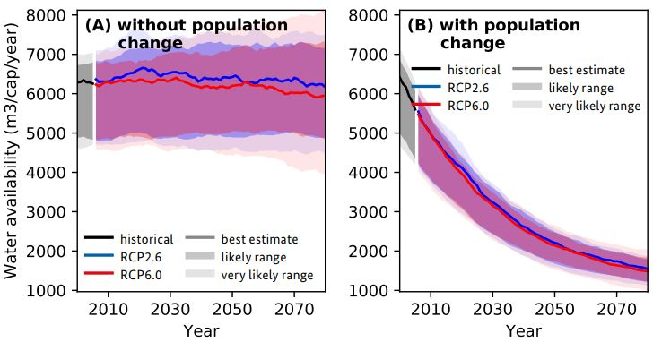
Climate
Temperature increase
Precipitation uncertain
More extreme rain
short wet season, longer dry season
Population growth
Notes:
To build reservoirs for future demands, it is important to know more about how the climate in Burkina Faso is going to change. Because of this, I will point out most important changes.
As can be seen in the upper left graph, the temperature is expected to rise significantly in both cases. The upper right graph shows predictions for the yearly amount of precipitation. This is an average of more models, which indicated that it is not certain whether the yearly amount of precipitation will increase or decrease.
One thing that could be concluded about precipitation, is that there will be more extreme rain events. When the yearly amount of rain would stay the same, this would mean that dry spells will become longer. The past years, this was already observed in seasonality: with a shorter, but more intense rainy season and a longer dry season.
Altogether, the total yearly water availability is not expected to change a lot. But since the population is expected to quadruple by 2100, the water availability per person decreases very much. This is expected to be the most challenging part of future water availability in Burkina Faso.

Slide 7
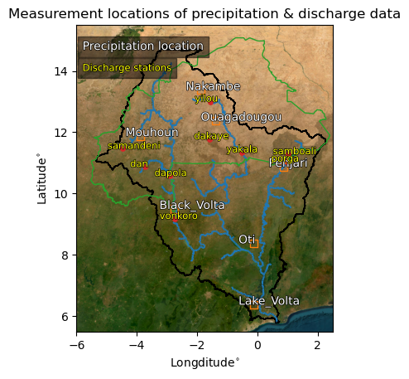
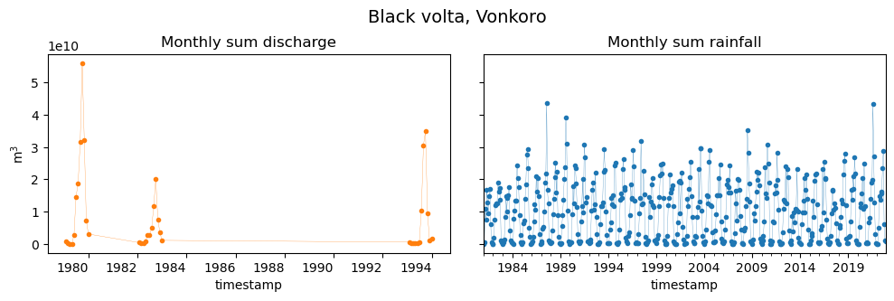
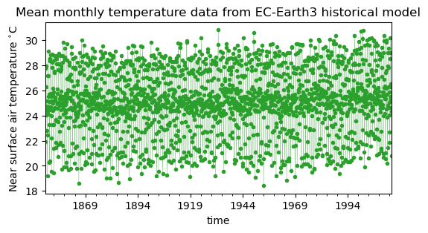
Data availability

Slide 8
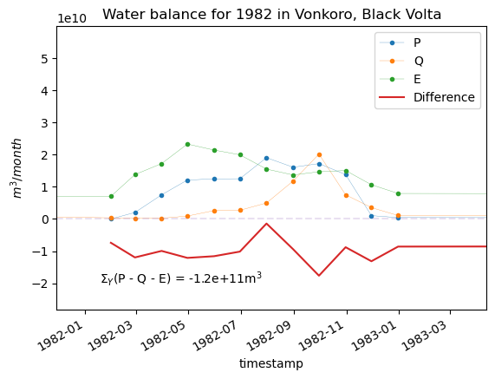
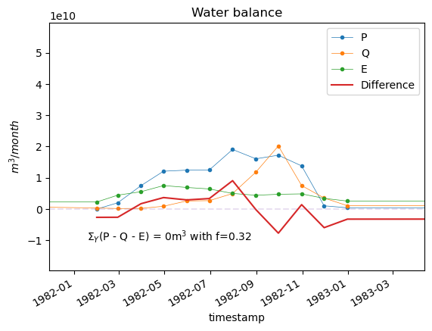
Yearly water balance
Ea = f * Ep
Ep: Thornthwaite

Slide 9
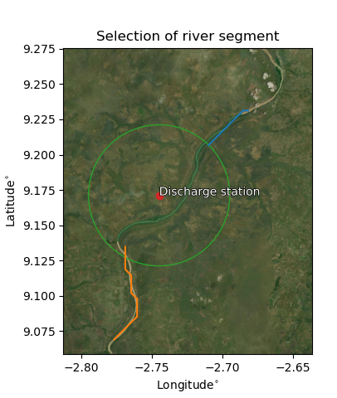
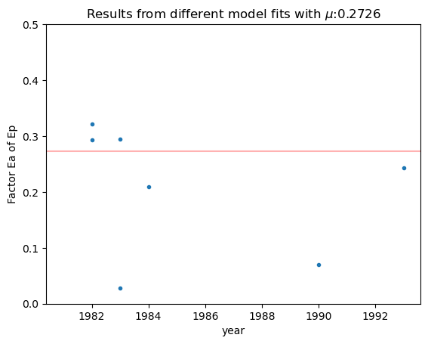
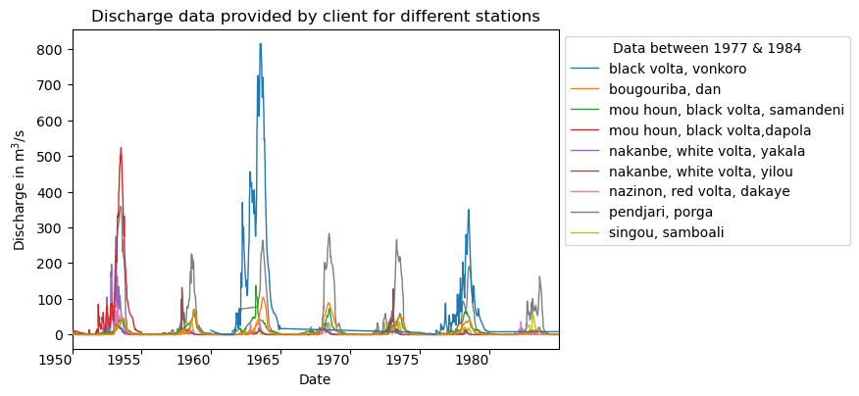
Fit factor for Actual evaporation

Slide 10
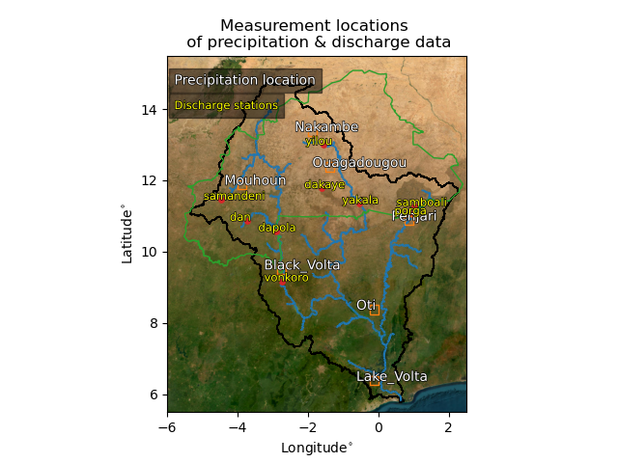
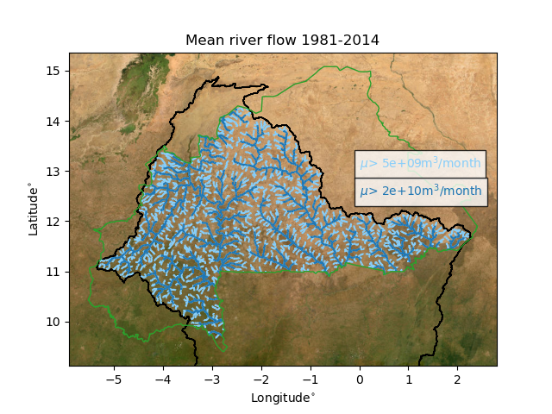
Implementation

Slide 11
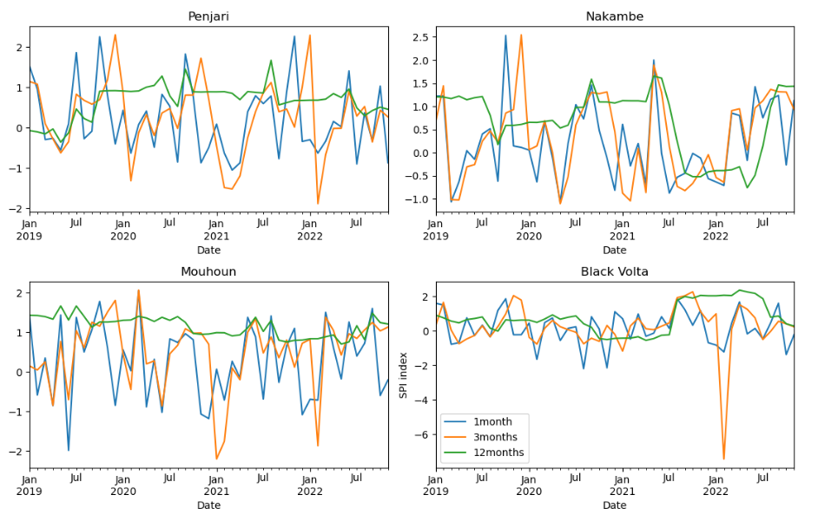
Drought analysis: Standardised Precipitation Index
Notes:
Green line shows across 12 month there is no drought, but 1 and 3 monthly periods there are times of drought. This shows reservoirs indeed a good option, since monthly and three-monthly drought peaks, but on yearly basis little to no drought

Slide 12
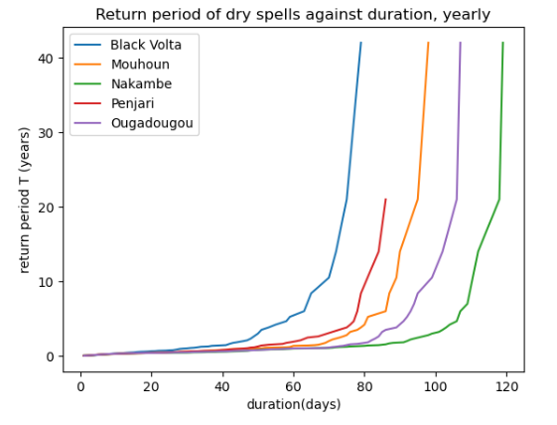
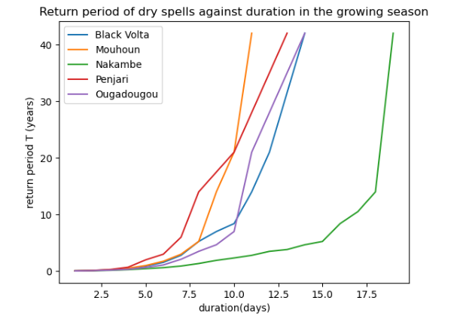
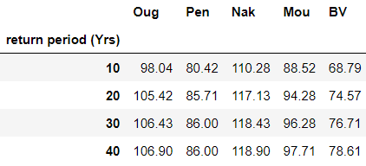
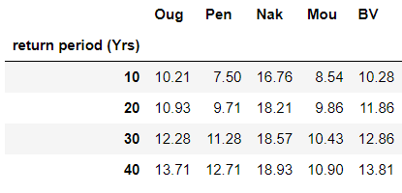
Drought analysis: Dry spells
Yearly
Growing season

Slide 13
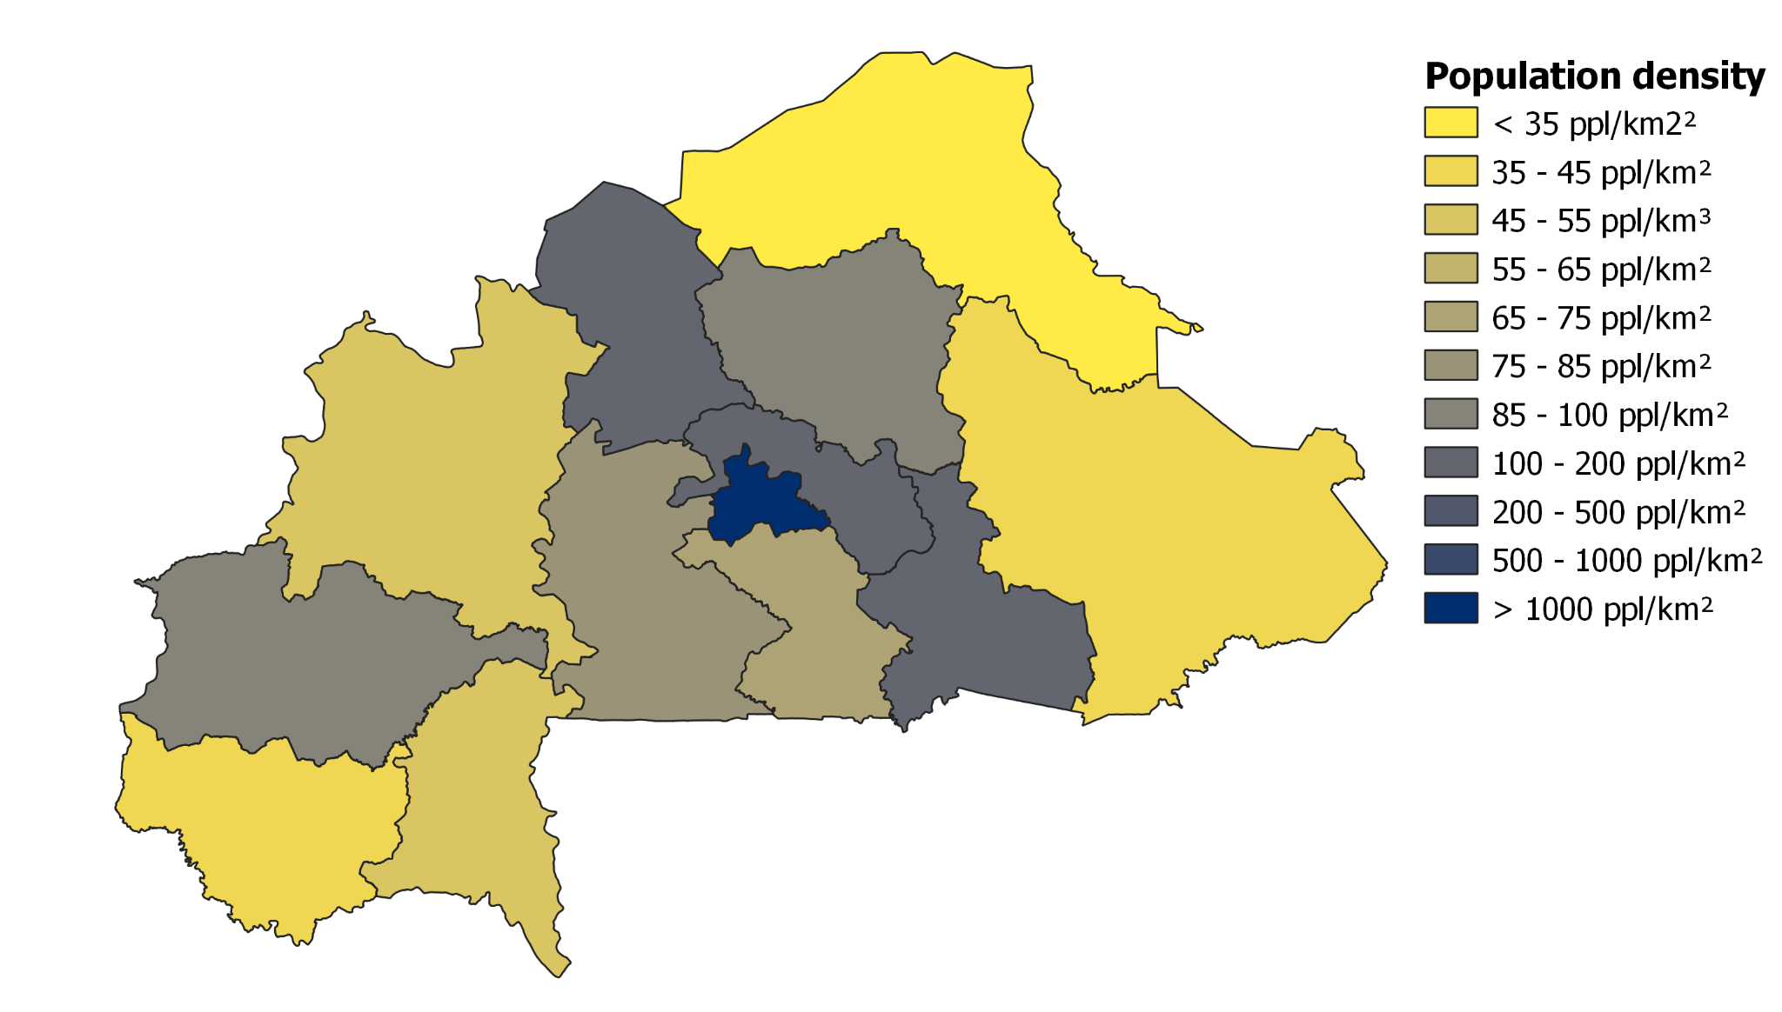
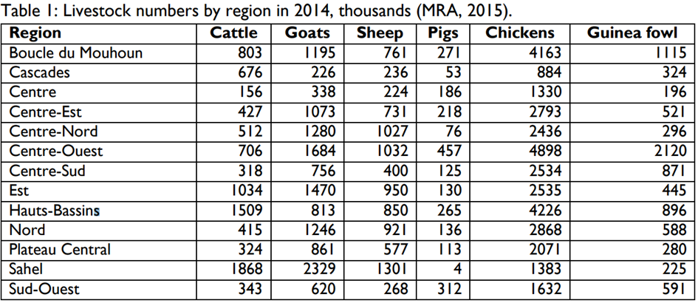
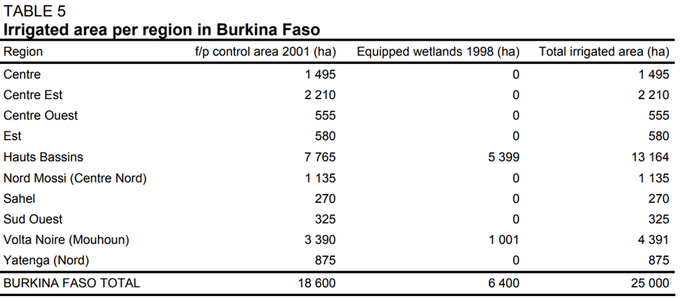
Calculation of the regional water demand
Sectors
Domestic
Livestock
Irrigation
Calculation of regional water demand by scaling the available information with their growing rate and applying the local water demand per unit

Slide 14
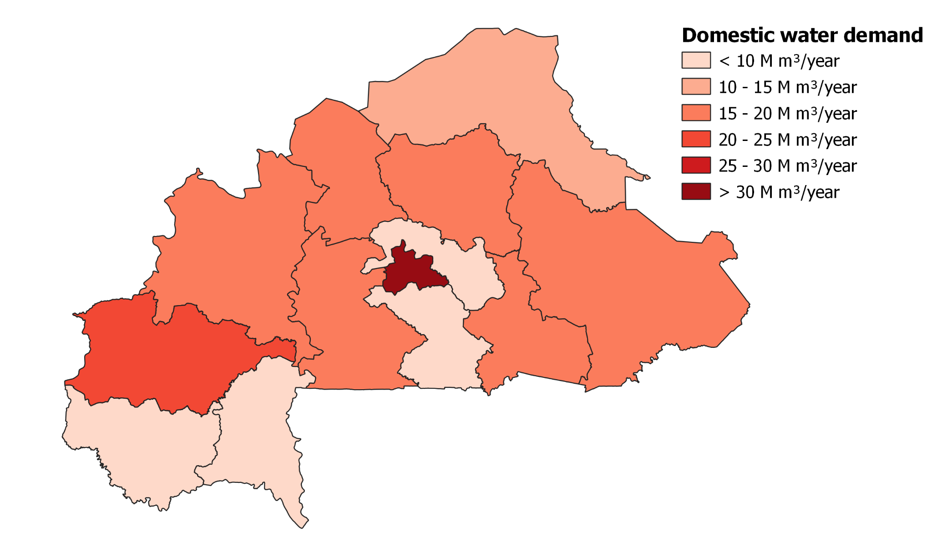
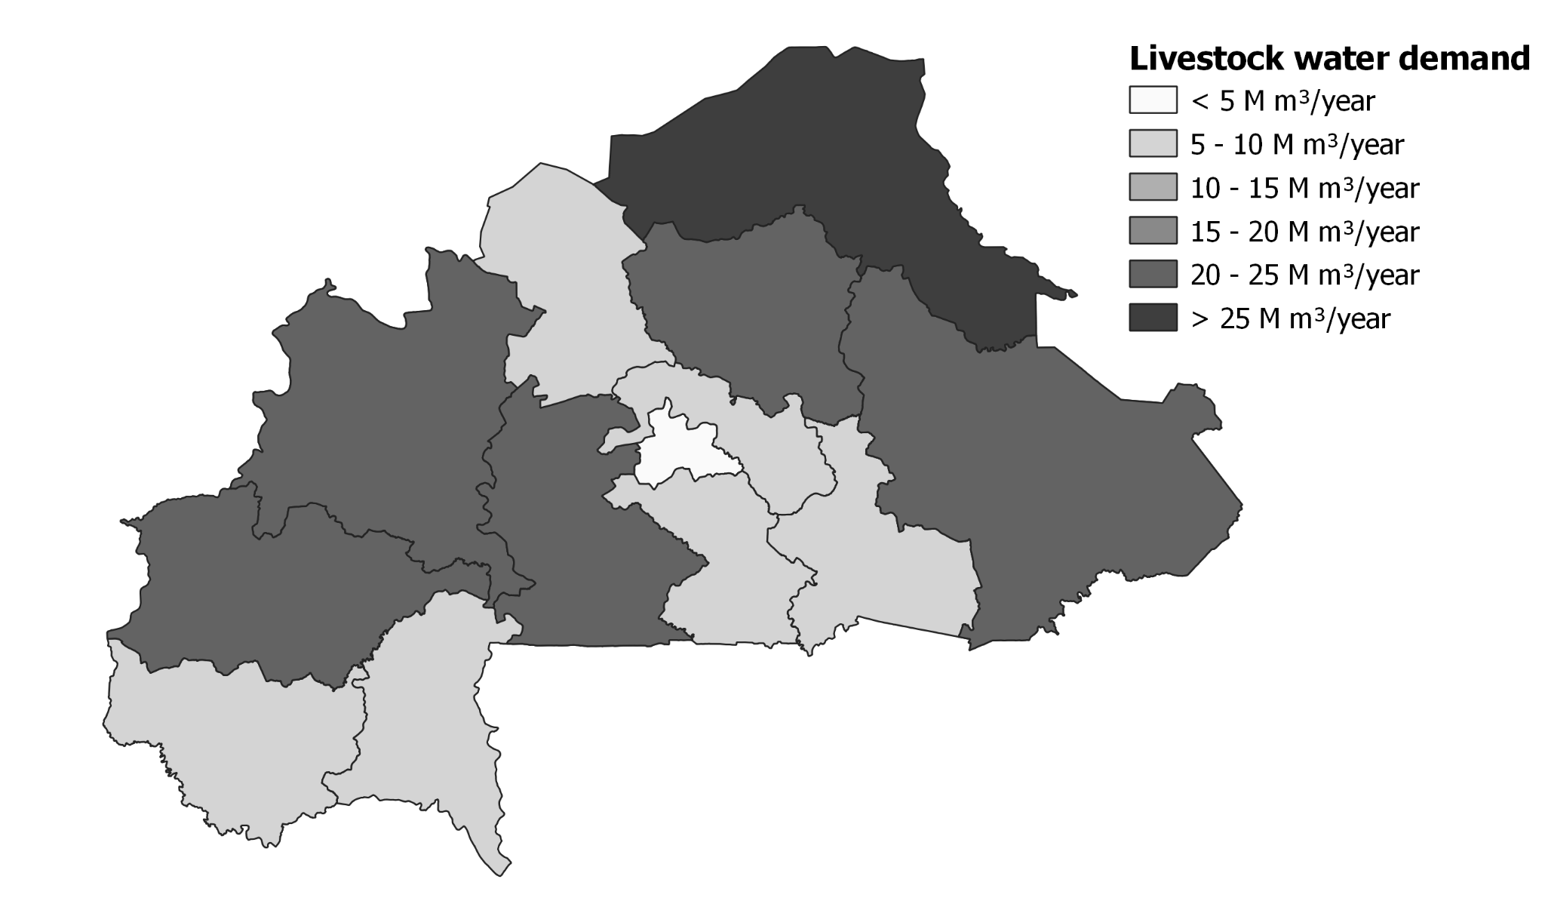
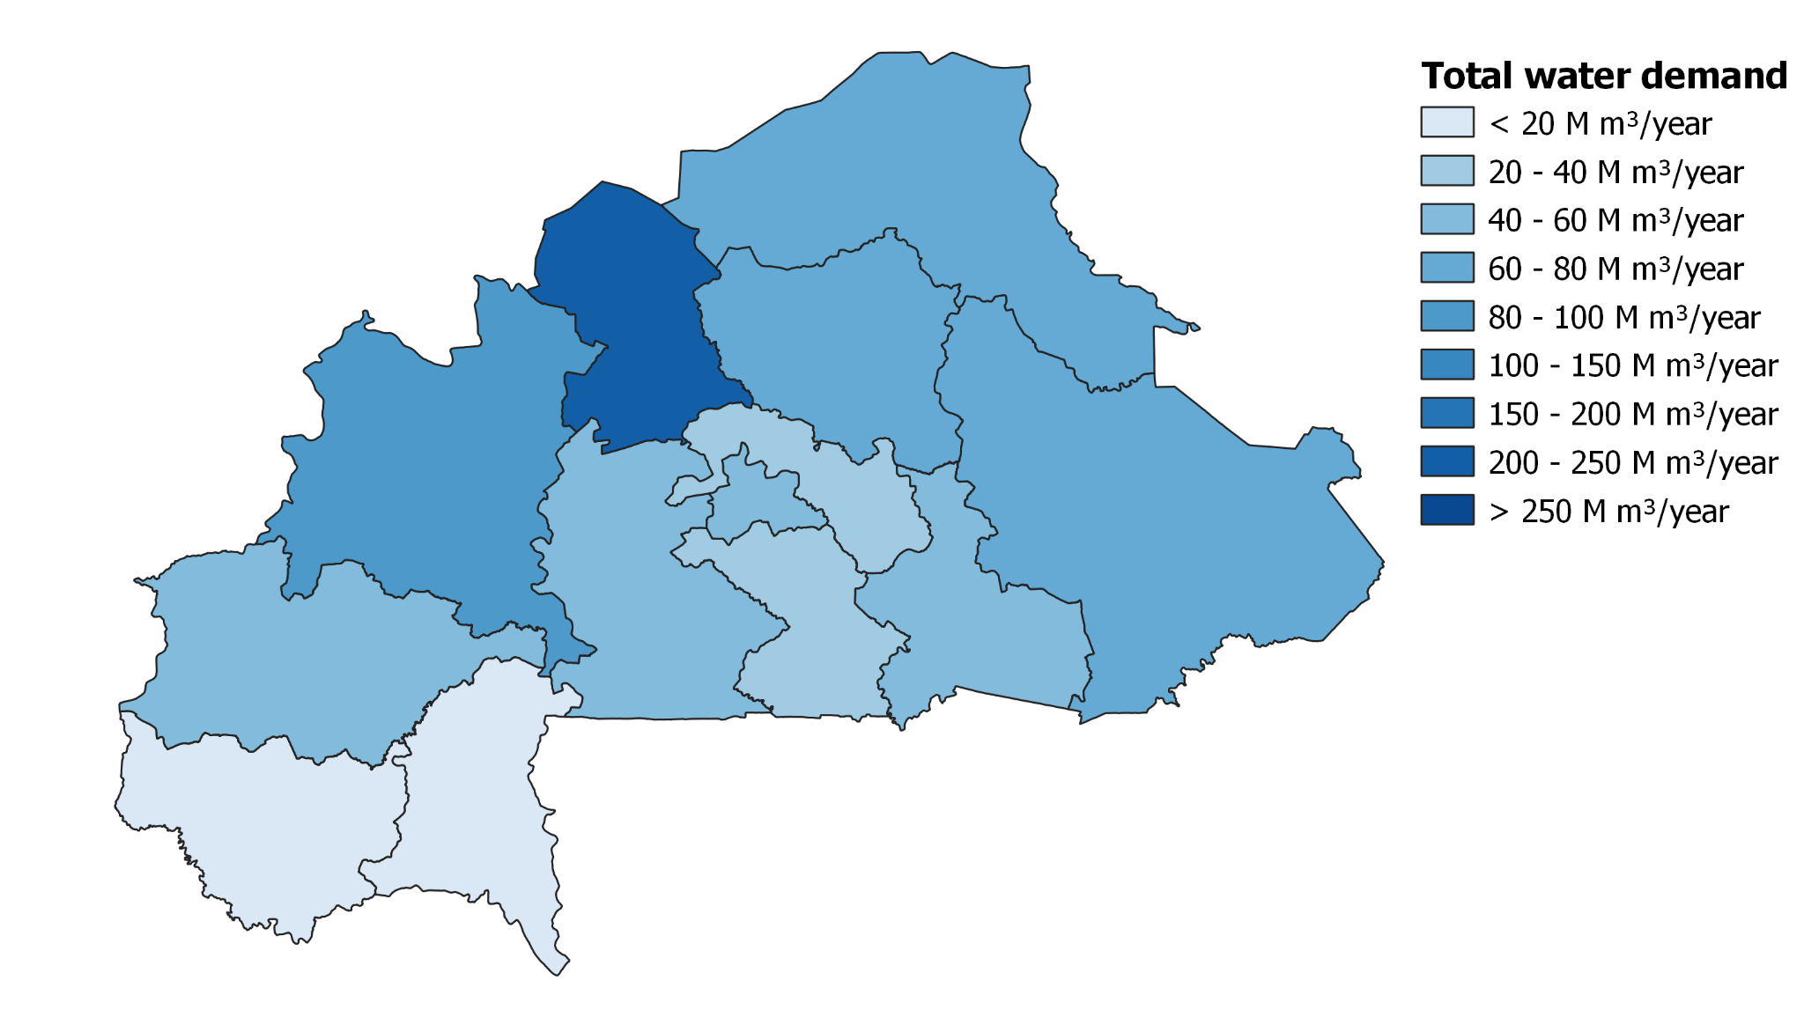
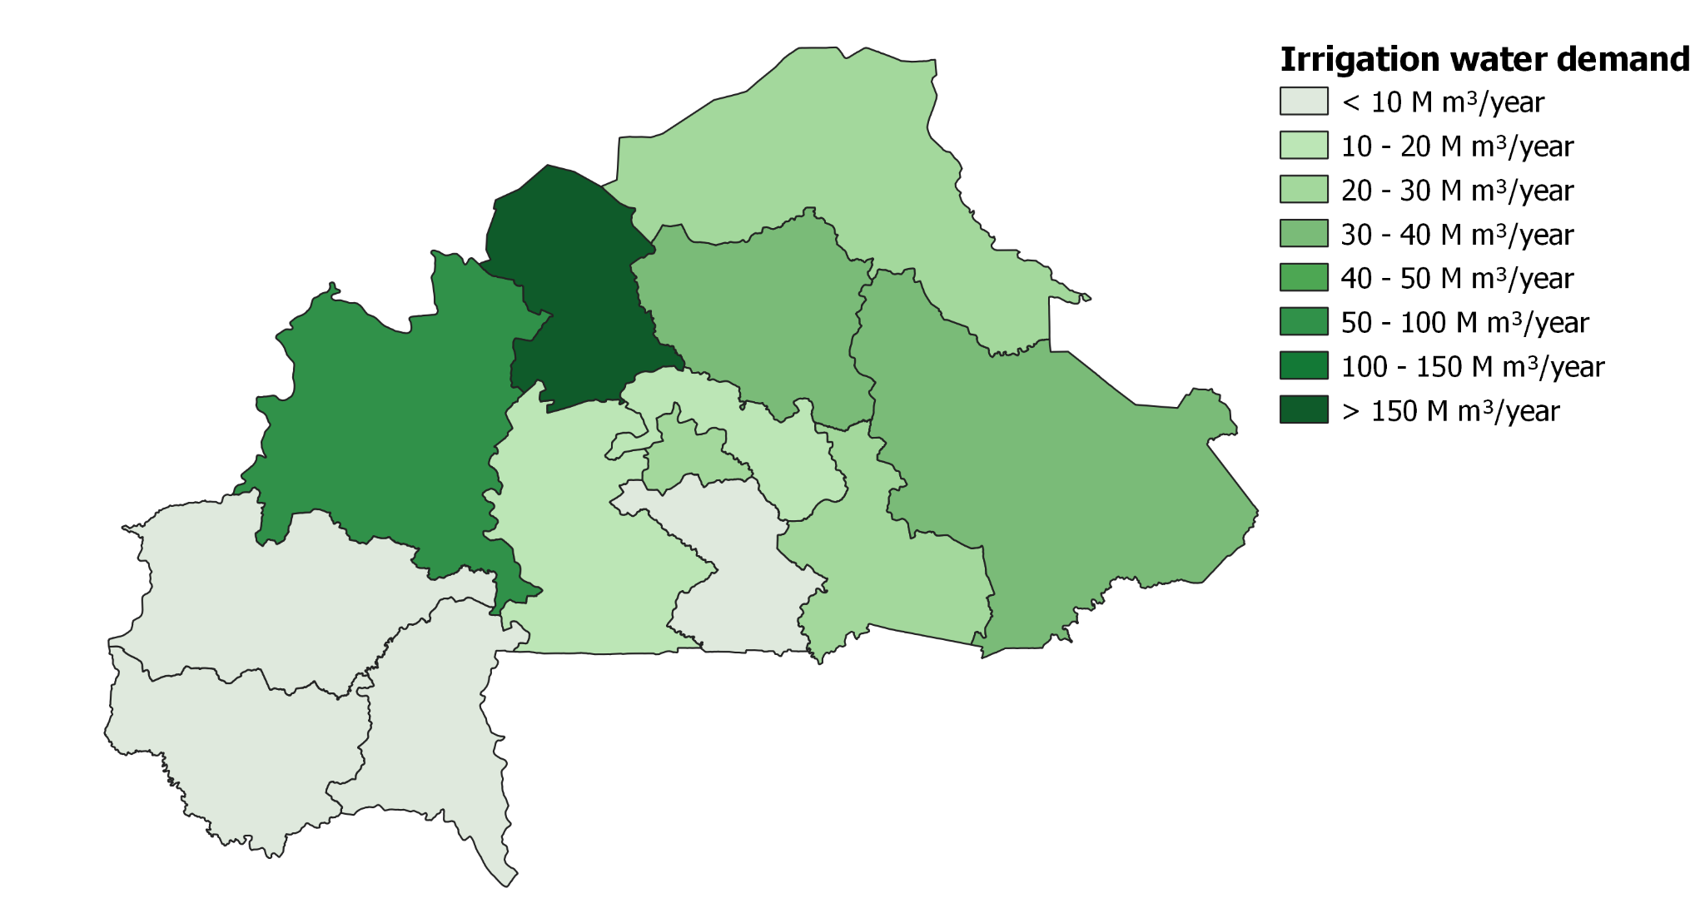
Water demand

Slide 15
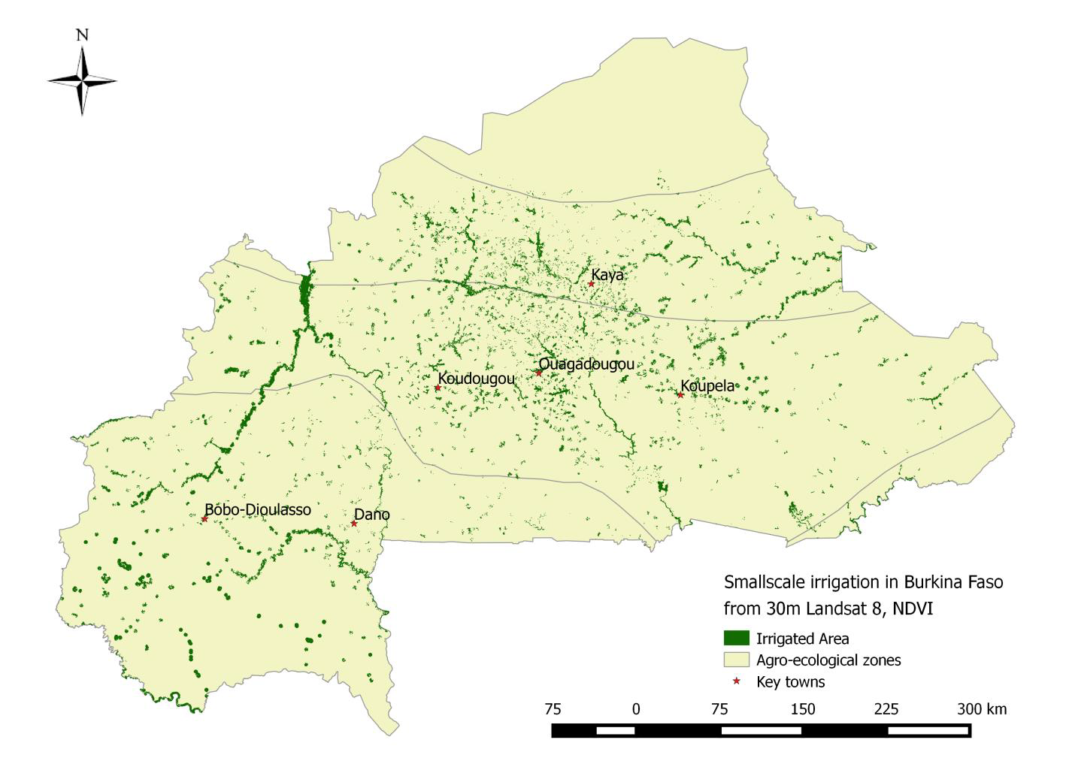
Irrigation areas
Sector with highest water demand
High uncertainty in the quantification of the area
Small scale irrigation is often not taken into account for statistics
Small reservoirs are mainly used for small scale irrigation

Slide 16
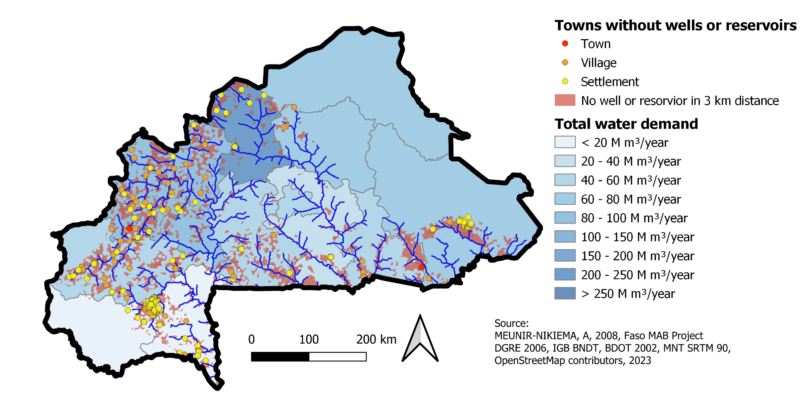
Recommended locations for new reservoirs

Slide 17
Final sprint
Estimate future water demand based on population growth and climate change
Calculate feasible dimensions of a reservoir based on water availability and demand
Including existing reservoirs in t.0.he search for recommended reservoir location
Determine areas where building new reservoirs would be recommended

Slide 18
Thank you for your attention

